Slide 1
Click here to Watch intro video
Green certified innovative
modular interior systems

Slide 2
Very innovative
Unique, different and patent applied
Sophisticated engineering
Very High performance
Made completely in India
Features
& benefits

Slide 3
Ultra fast installing
Minimum Human labour on site
Highly Customizable, Modifiable, Relocatable
in future as per requirements
Very economic pricing

Slide 4
Architects & designers
Flexible in design for unique aesthetic expression of architects & designers
End Users
Highly customizable for better product-user fit and changeable as per future requirements
Contractors
Reduce time from many weeks to days with minimum labour

Slide 5
These systems can increase the chance of survival and success of businesses & investors by reducing time of project completion & capital investment
while delivering contemporary & maintenance free interiors which is
customized as per requirements of all stake holders as well which is
Modifiable / relocatable to serve their future requirements
Business & Investors

Slide 6
Baffle ceilings | Ceiling trap doors | Glass Partitions | Demountable solid partitions
Paneling | Workstation leg systems & accessories
Floor junction box | Electric floor box | Floor raceways
Open frame rack systems – CTR CDR Racks Partitions
widest range of modular interior systems

Slide 7
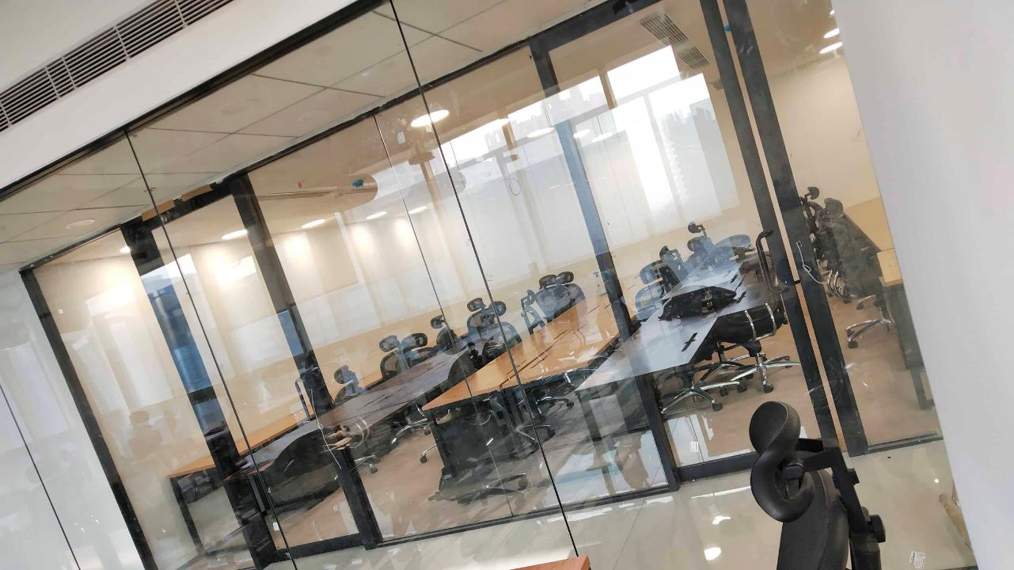
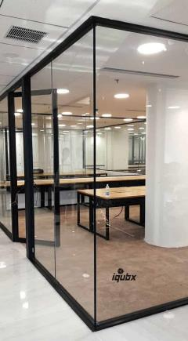
Glass partitions

Slide 8
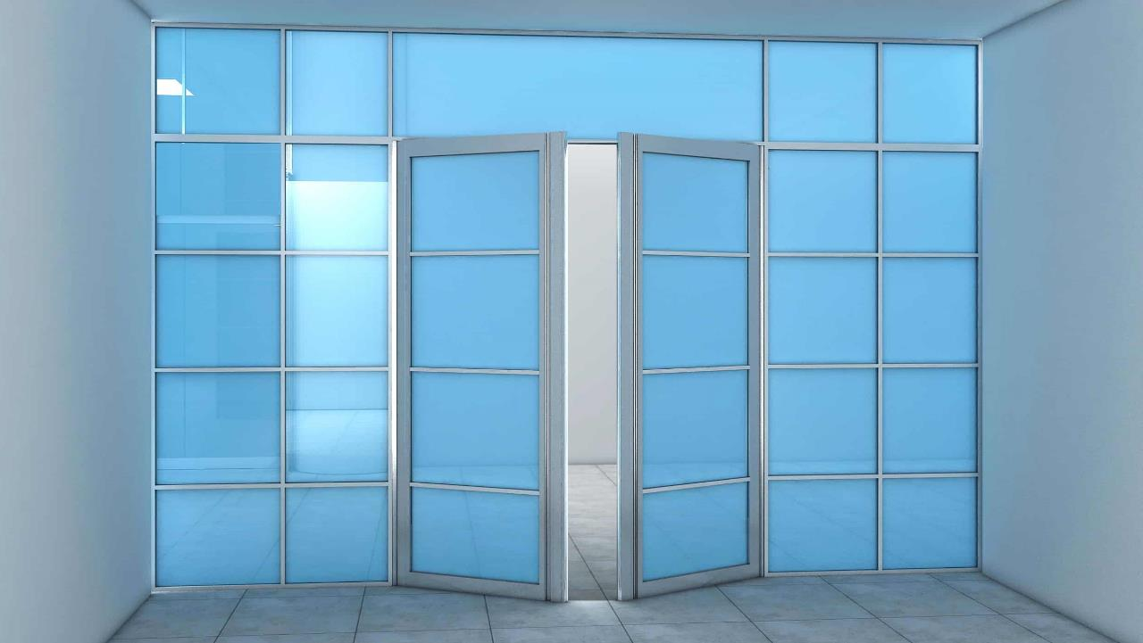
Glass partitions

Slide 9
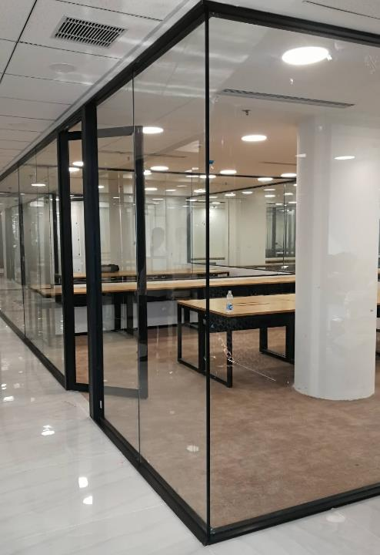
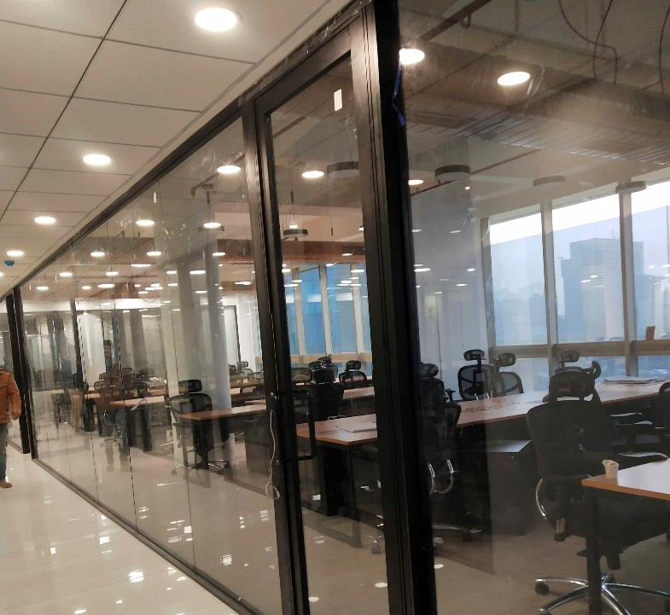
High performance
Click here to Watch product video
High acoustic insulation – noise reduction and privacy
Modifiable
Single glass can be upgraded to double glass and VIG glass for more acoustic performance any time
Fast installation
Highly engineered sections and joinery can reduce time of installation by half
To download go to the webpage
Relocatable
Go to webpage
Glass partitions

Slide 10
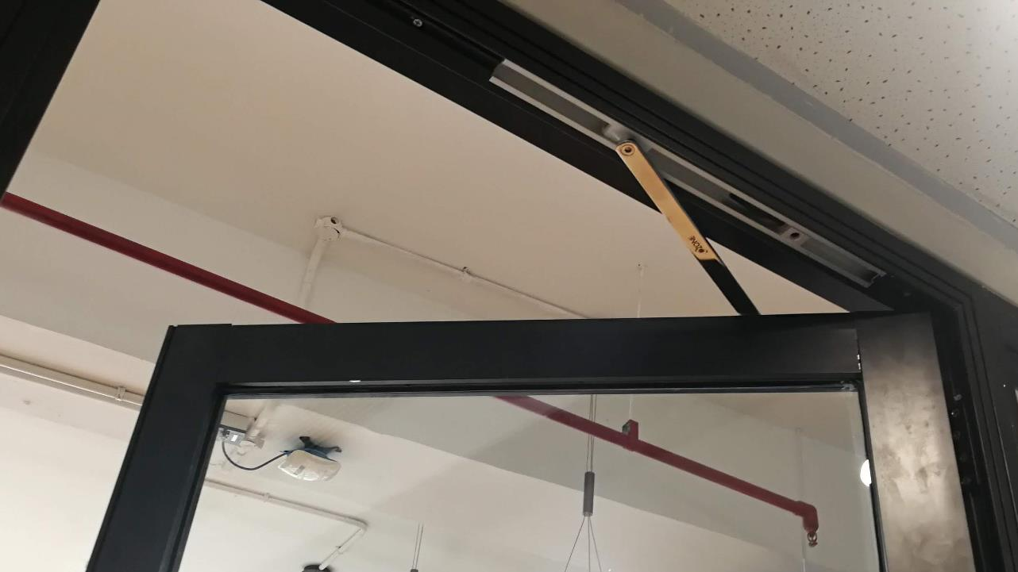
High performance
High acoustic insulation – double door seal in door as well as frame
Unique design
GD01 can have single as ell as double glass and has built in handle
DF01 door frame can be used in partitions as well as walls
Fast installation
Highly engineered sections and joinery can reduce time of installation by half
To download go to the webpage
Glass doorwebpage
Door frame webpage
Relocatable
Modular Glass door & frame

Slide 11
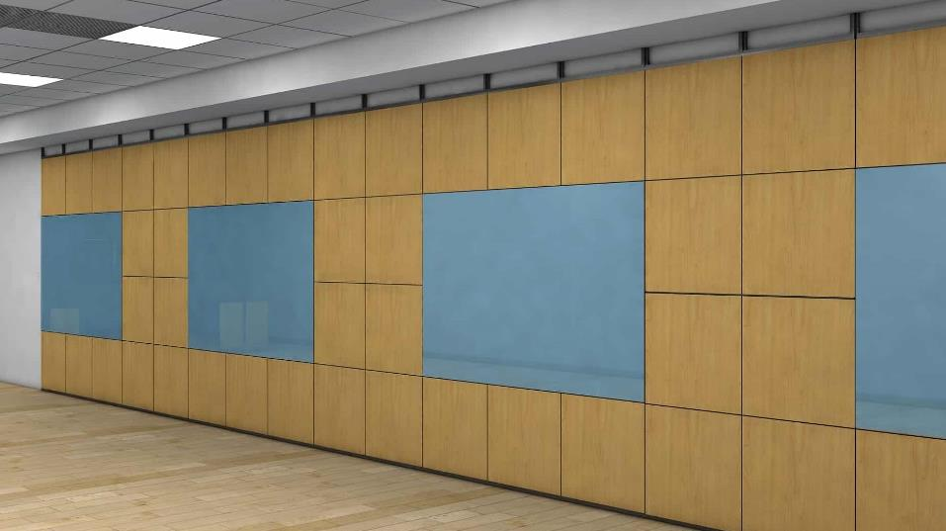
High performance
High acoustic insulation with multiple gaskets and continuous acoustic insultation inside
Click here to Watch product video
Removable panels
Allows changing panels finishes like installing glass writing boards etc any time as well as maintain and changing electrical wirings inside
Fast installation
To download go to the webpage
Highly engineered sections and joinery can reduce time of installation by several times
Partition webpage
Paneling webpage
Relocatable
Demountable partition & paneling

Slide 12
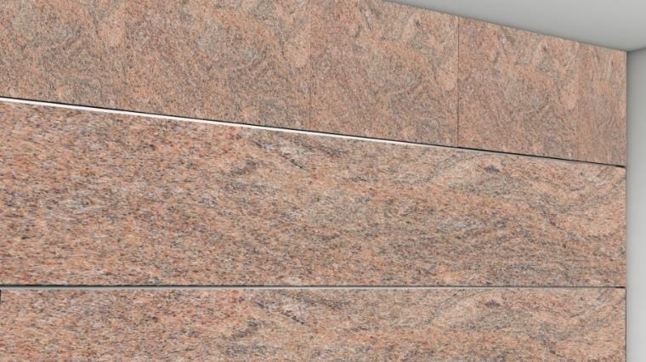
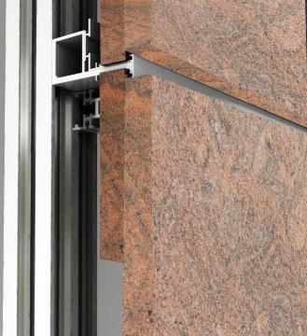
^{100%} dry construction
Complete dry frame with high engineered section installed by a single team in 1 stage
Click here to Watch product video
Removable panels
Allows changing panels finishes any time as well as maintain and changing plumbing inside
Fast installation
Being a single stage construction with precut stone, tile or HPL panels, ultra fast construction – can bring down construction time from many weeks to a few days
To download go to the webpage
Go to webpage
Relocatable
Dry wall cladding walls

Slide 13
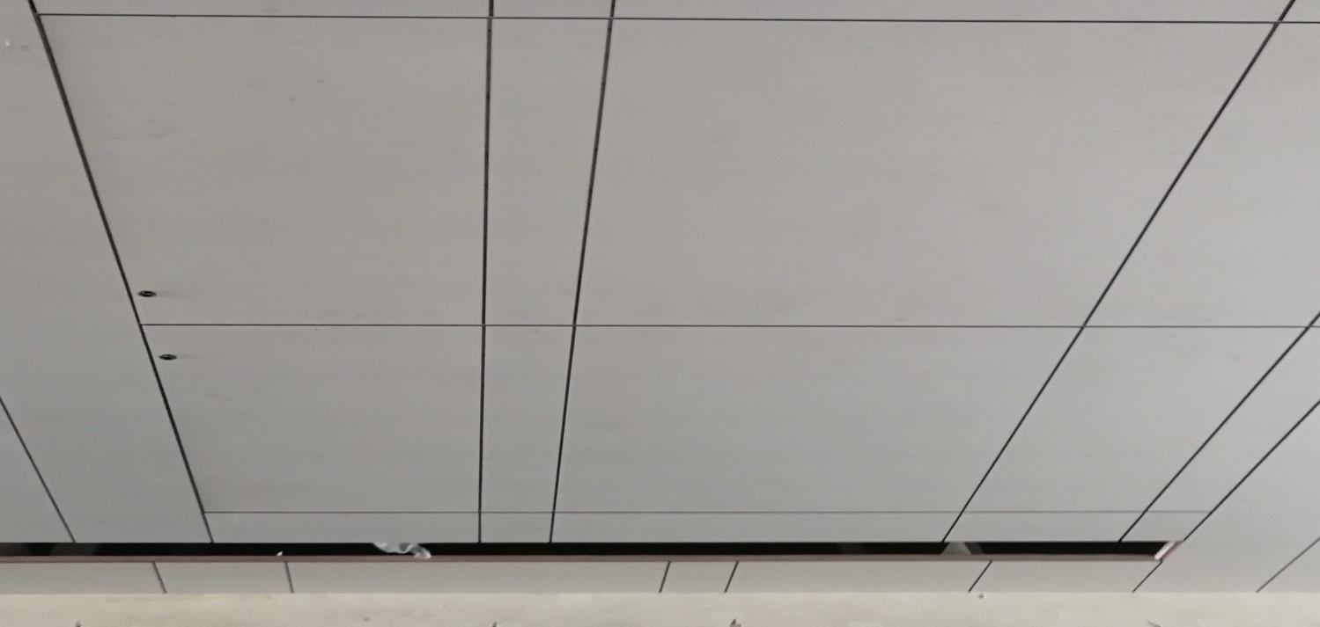
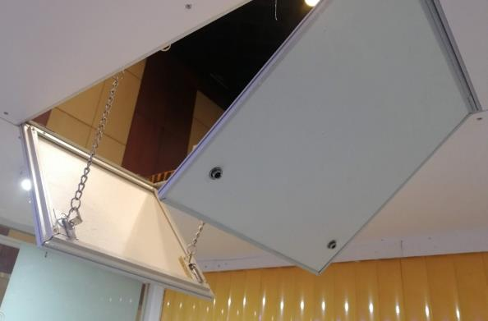
Very big sizes
We make ceiling trap doors of biggest sizes and deliver all over india; We make them as per customer sizes with minimum TAT
Click here to Watch product video
Unobtrusive
They have same finish as rest of ceiling and just a 2mm groove all around
Fast installation
They are very simple and fast to install
To download go to the webpage
Safe and strong
Go to webpage
They are engineered not to bend or warp and athe shutters cannot fall down dur to inbuilt locking
Ceiling Trap Doors

Slide 14
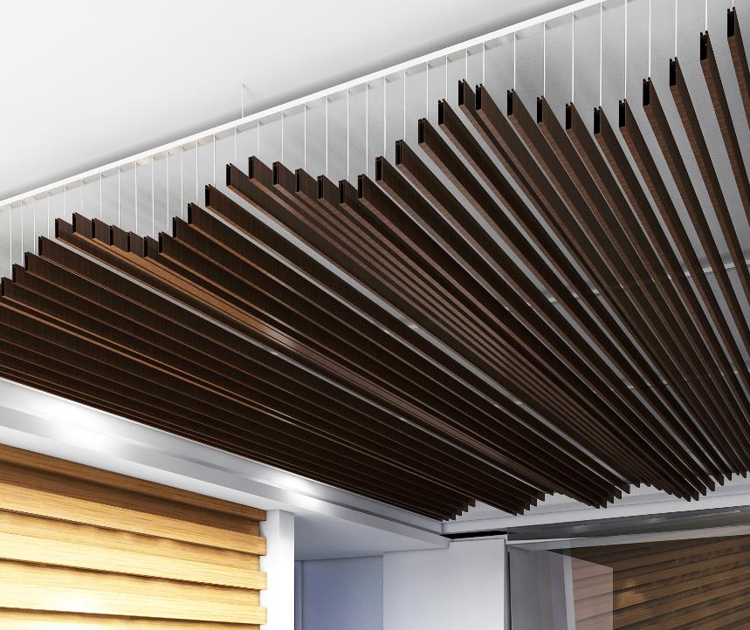
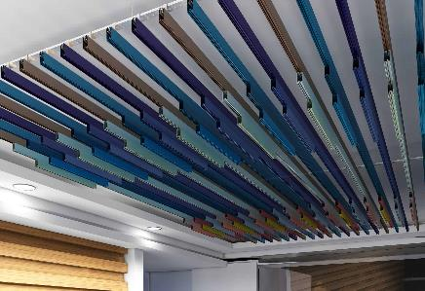
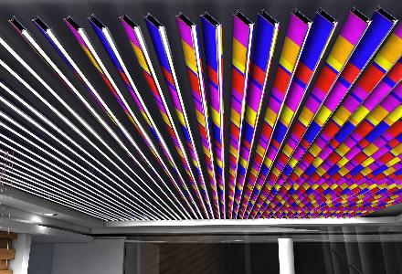
^{Patent} unique designs
Very unique designs not available any where in the world
Baffles with changeable unique finishes like lacquered glass, cork, veneer, printed vinyl, laminate etc
Cost effective Baffles with any height and high NRC value
Stackable modular baffles
Baffles in solid colours as well as wood finishes
To download go to the webpage
Go to webpage
Modular Baffle Ceilings

Slide 15
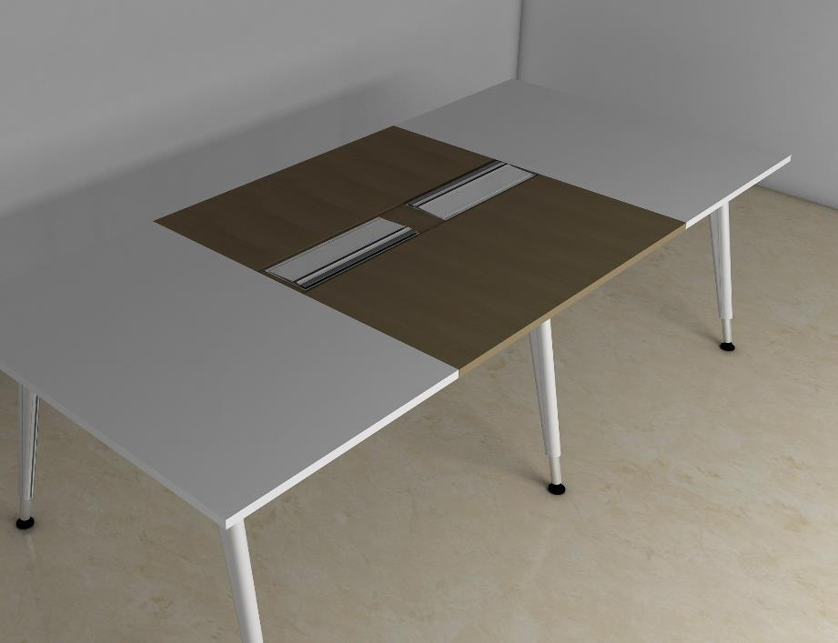
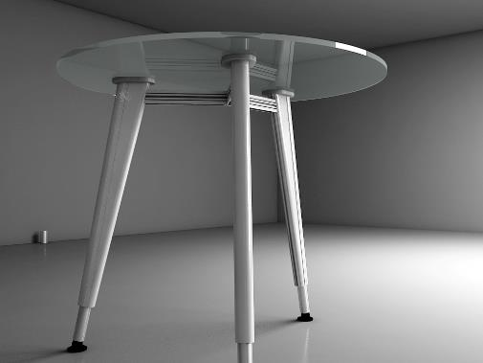
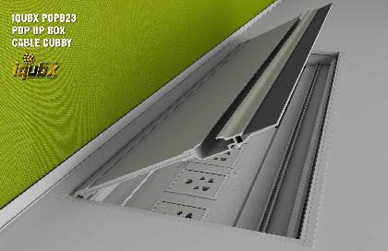
Go to webpage

Slide 16
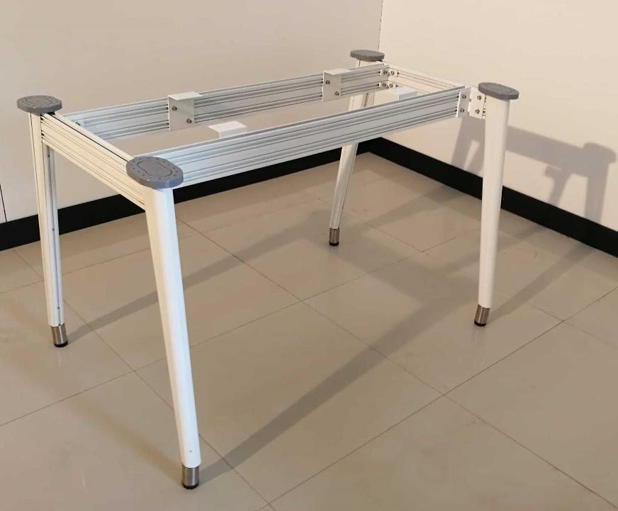
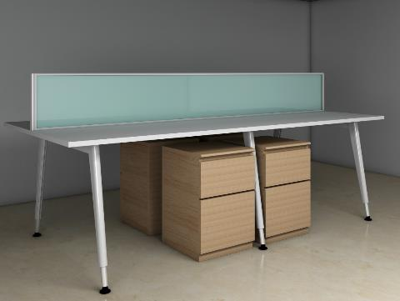
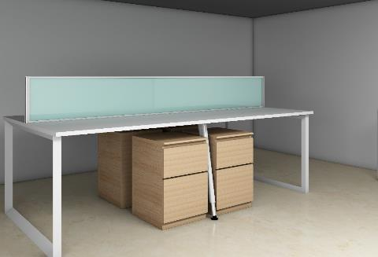
Transformer
DIY kit completely assemblable on site, with changeable configuration from shared to nonshared, single to double etc as per requirement
Unique design
Unique contemporary sleek design
Fast installation
Highly engineered sections and joinery can reduce time of installation by half
To download go to the webpage
Go to webpage
Modular table leg systems

Slide 17
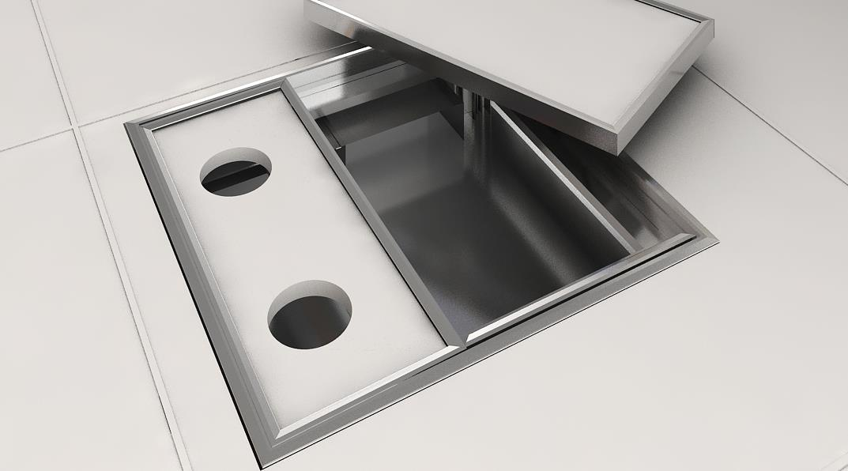
Modular Floor Junction Boxes

Slide 18
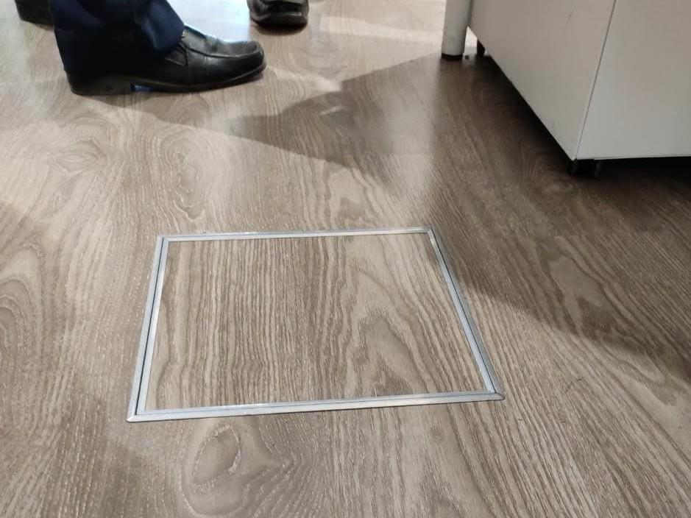
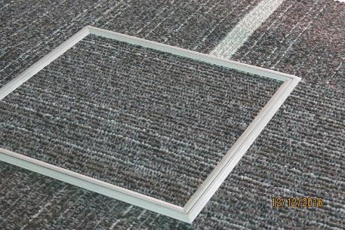
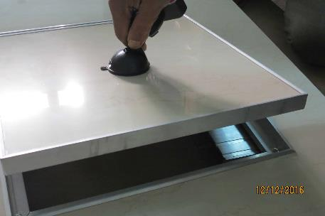
Patent design
Unique solution for every project, can be provided in any shape and size, hinges & wire manager optional
Same floor finish
Lid design accommodates same floor finish like stone, tile, carpet, wood for beautiful interior
Safe strong hygienic
Lid design doesn’t come loose like old fashioned ugly plates which can hurt. Prevents entry of dust & rodents
Can be retrofitted
To download go to the webpage
Go to webpage
Can be retrofitted in old MS or GI floor junction boxes any time
Modular Floor Junction Boxes

Slide 19
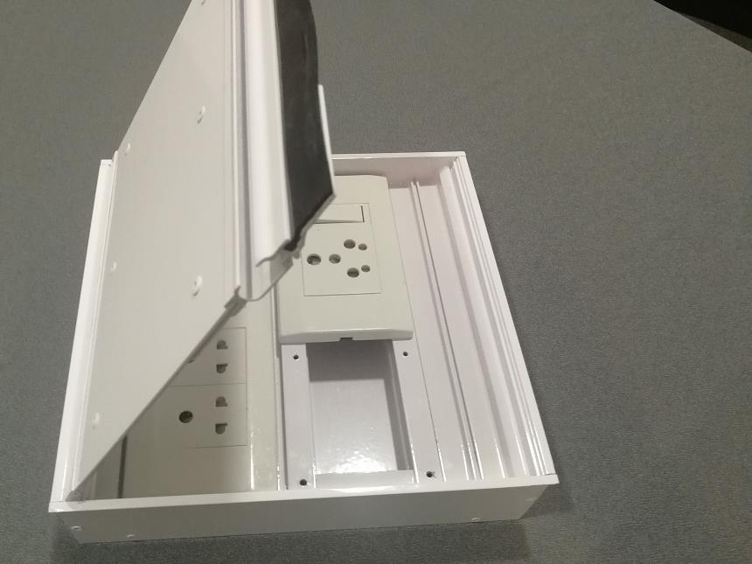
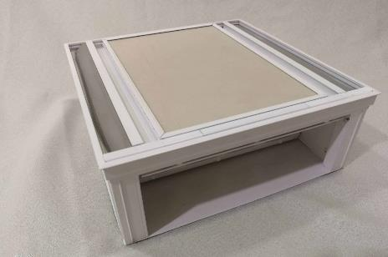
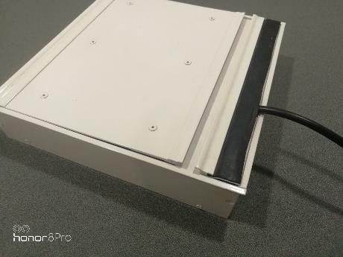
Modular design
World’s first multi bay modular design cn be provided in any number of bays and any length
Thinnest design
FB01 is just 55 mm thin and can be installed in any floor finish
Can be retrofitted
Can be retrofitted in old floor boxes which break easily
To download go to the webpage
Go to webpage
Modular Floor Boxes

Slide 20
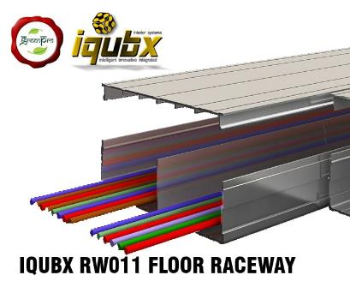
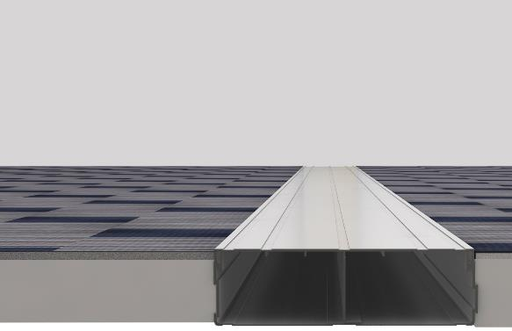
Modular design
World’s first professionally designed raceways which are stackable horizontally in multiples of 150 mm; designed to fit snug in substrate
Snap fit lid
Snap fit lid makes it easy to install, even exposed to floor finish, strong enough to carry good load
Can be retrofitted
Can be retrofitted in any interiors to carry cables across without complete floor dismantling
To download go to the webpage
Go to webpage
Modular Floor Raceways

Slide 21
www.iqubx.com
Green certified modular
interior systems
Customized
solutions

Slide 22
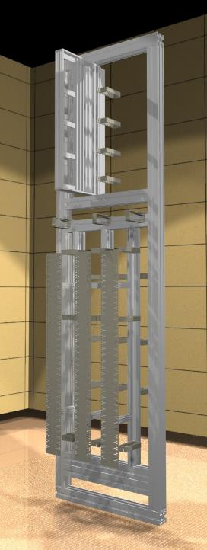
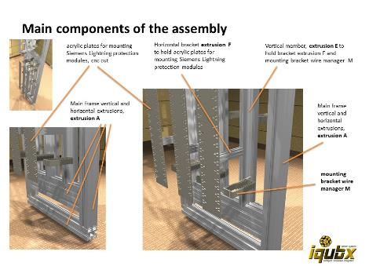
Siemens
CTR-CDR
For
Delhi Metro
Import substitute

Slide 23
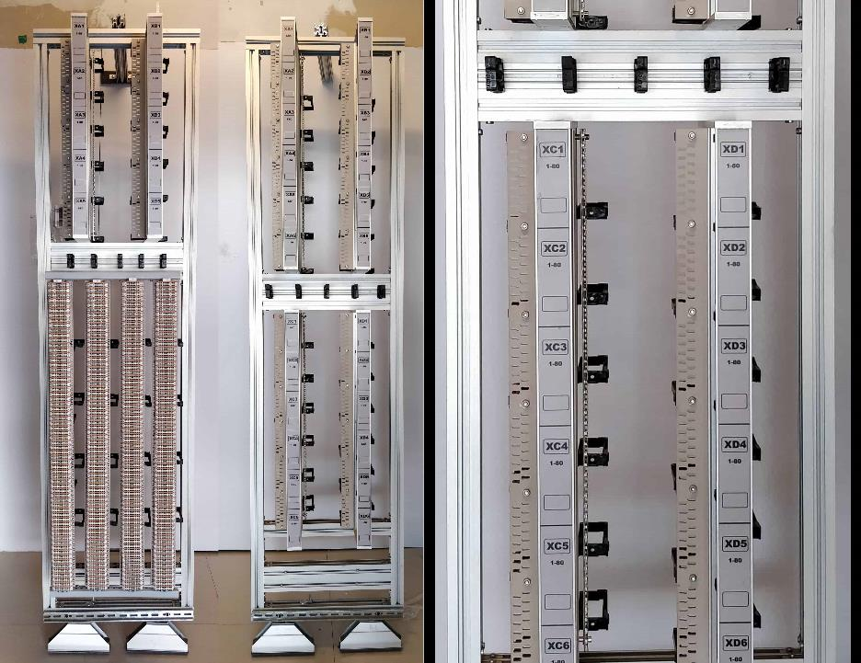

Slide 24
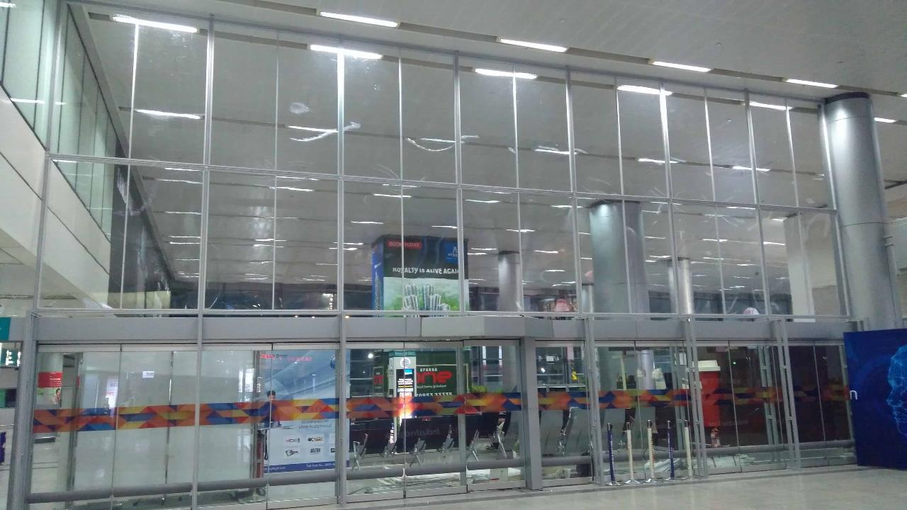
GMR Hyderabad airport
80’ x 25’ partition

Slide 25
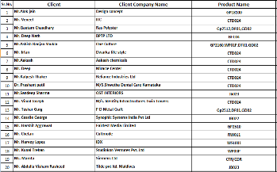
Our Clients

Slide 26
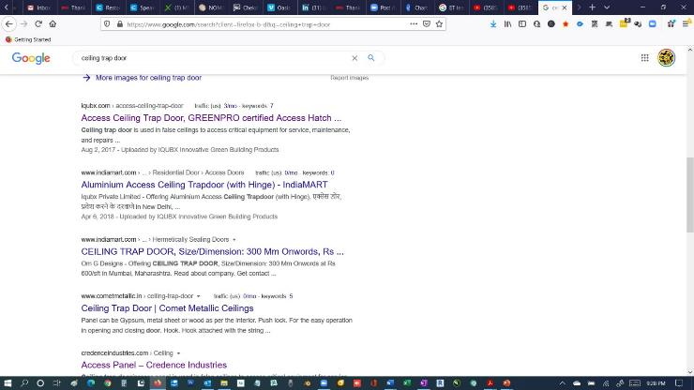
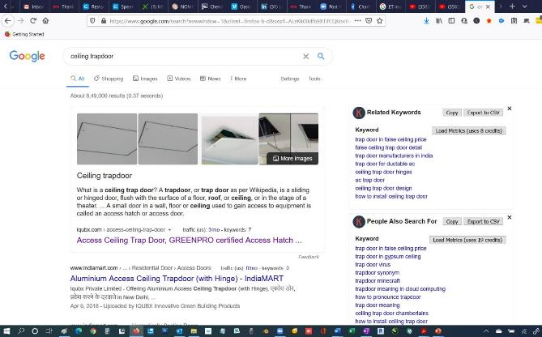
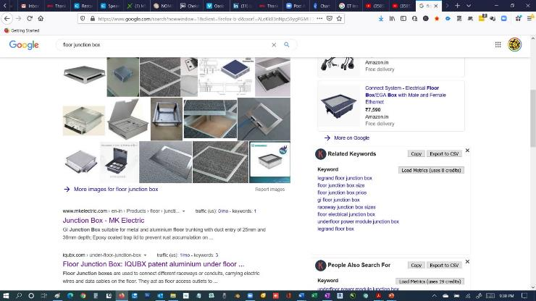
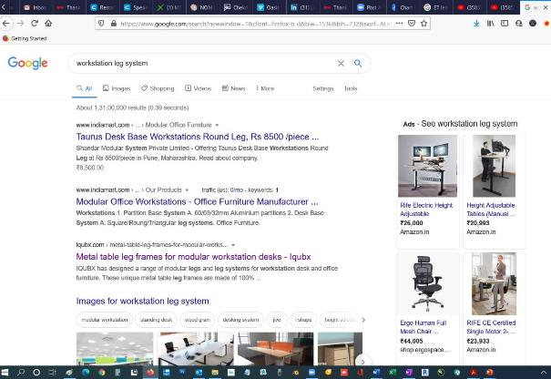
Google search engine
Pg 1 Rank 1
Pg 1 Rank 1
Pg 1 Rank 2
Pg 1 Rank 3
Pg 1 Rank 8

Slide 27
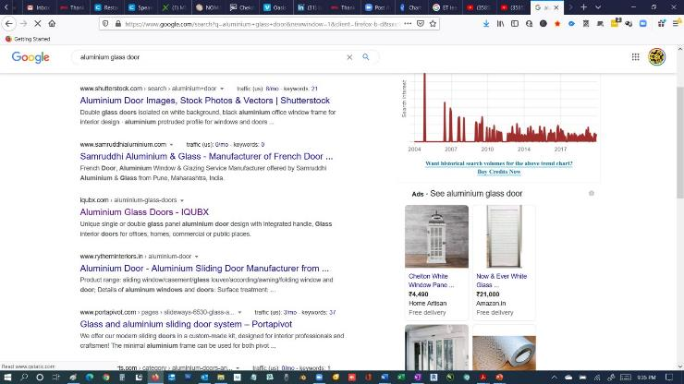
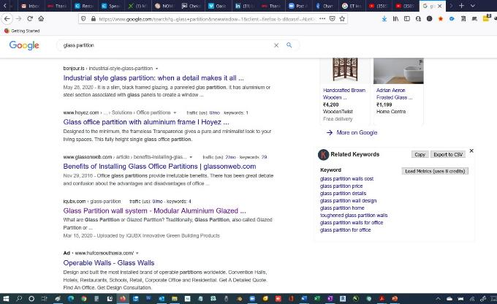
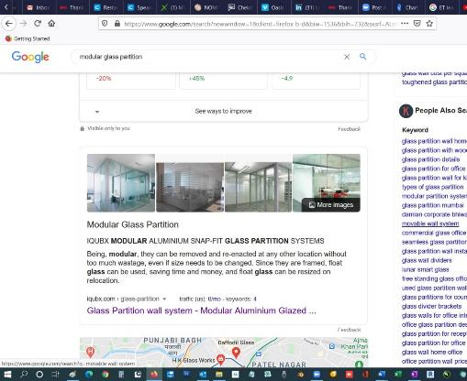
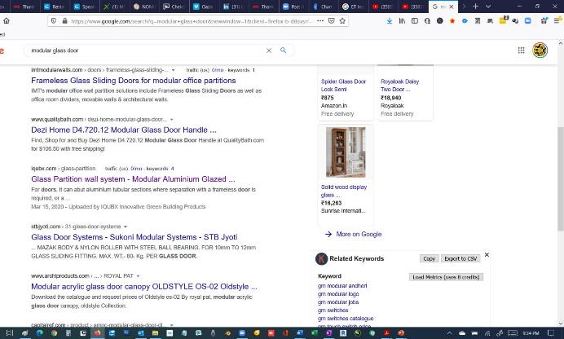
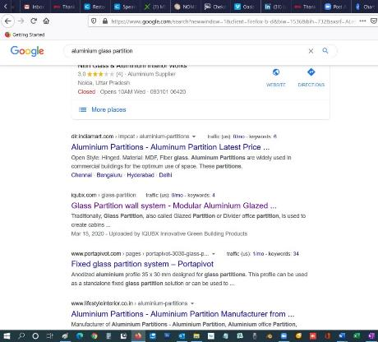
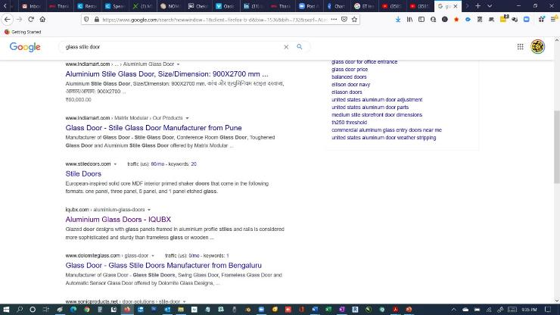
Pg 3 Rank 4
Google search engine
Pg 3 Rank 10
Pg 1 Rank 2
Pg 1 Rank 1
Pg 2 Rank 6
Pg 1 Rank 4

Slide 28
Hi Amit,
As discussed we have used your IQUBX profiles for both the partitions and the workstation legs and find them to be of good quality, and allows us the versatility to configure permutations and combinations of workstation layouts. We are now planning to introduce these systems in to our catalogue range and offer it as a complete solution to our clients.
We and look forward to and long and mutually beneficial working relationship with IQUBX.
Regards
Harvey Lopez
Project Management Director
Testimonials

Slide 29
Sat, 29 Aug 2020 16:16:22 +0530 amitsharmacs1975@gmail.com wrote
Dear Sir,
We have got trap doors installed for our Centralised AC for our residential building in Gurugram, Haryana. The first point of contact was Mr. Sumit from IQUBX. We have got truly professional service from him. The product quality is excellent and they deliver what they promised. The trap door is light weight and completely matched with our ceiling.
Thanks IQUBX.
Regards,
Amit Sharma
karan.razdan@skvindia.com
Hi,
We, as a company are one of the leading Design and build commercial Interior fitout company. Furniture and fixtures are one of the most important elements in any and every project that we do.
We came across Amit and Iqubx while searching for economical yet sustainable modular partitions solution for our project.
I say this with delight that Amit and team have done a splendid job in providing a perfect modular partition solution. The product is one of th best modular systems available in the market highlighting and covering the gaps in the existing systems.
I wish Amit and team all the very best for their future endeavours.
Keep shining!
Best regards,
Kunal Trehan
Business Head - Furniture division
SKV
Wed, 02 Sep 2020 3:52:48 PM +0530
IQUBX offers unique and green certified products for all interior solutions. Mr. Amit himself being an architect has recognised the gap between what's available in the market and what architects and interior designers actually need. All the products are highly customisable which is a boon for all designers. Mr. Amit puts in time and effort to understand project requirements and gives the best possible solutions which are structurally sound as well as aesthetically pleasing. This cannot be said about other indian products available in the market.
I look forward to working with him and his team in the future!
Sincerely, Shweta Shah
studio | pomegranate
Sat, 29 Aug 2020 6:46:51 pm +0530 alocjain@gmail.com wrote
i had been looking for the clean, international look for my aluminum and glass partitions but could not seem to get proper solutions even after trying multiple markets and vendors, till i reached out to iqubx.. their sections are sleek and unconventional, their push fit beadings click effortlessly in place and generate a crisp , clean, minimalistic mies van der rohe kind of corporate look in my office interiors. for ARCHITUDE aloc jain Architect

Slide 30
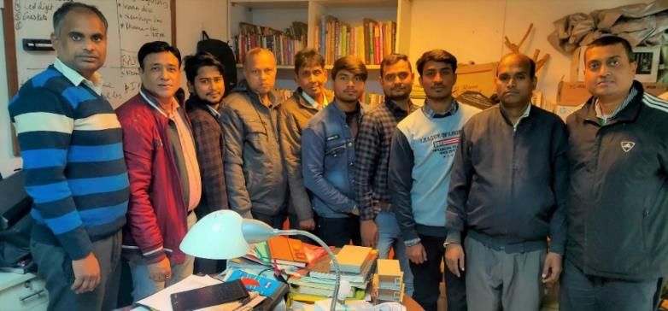
9811204811
9999001967
amit@iqubx.com
www.linkedin.com/in/amitgarg-iqubx
https://www.facebook.com/iqubx/
Call us for any inquiries
Please connect on linkedin
Like our facebook page
Visit our website
www.iqubx.com

